Slide 1
Intelligent Cloud Operations Part 2. OpenStack Cloud Operating System
Definition (Gartner) [AIOps]
AIOps platforms utilize big data, modern machine learning and other advanced analytics technologies to directly and indirectly enhance IT operations (monitoring, automation and service desk) functions with proactive, personal and dynamic insight.
Prof. Jorge Cardoso
E-mail: jorge.cardoso@huawei.com
Large-scale AIOps Lab/SRE Dept.
Munich and Ireland Research Center
2020
Notes:
Presentation adapted from the previous presentation:
AIOps: Anomaly Detection of Distributed Traces, National University of Ireland, Galway (NUI Galway), 2019.08.20
AIOps-driven Anomaly Detection in microservice architectures, ICT Autonomous Network O&M Conference
2019.06.27, Dublin, Ireland

Slide 2

Intelligent Cloud Operations The emerging field of AIOps
The field of AIOps, also known as Artificial Intelligence for IT Operations, uses advanced technologies to dramatically improve the monitoring, operation, and troubleshooting of distributed systems. Its main premise is that operations can be automated using monitoring data to reduce the workload of operators (e.g., SREs or production engineers). Our current research explores how AIOps – and many related fields such as deep learning, machine learning, distributed traces, graph analysis, time-series analysis, sequence analysis, advanced statistics, NLP and log analysis – can be explored to effectively detect, localize, predict, and remediate failures in large-scale cloud infrastructures (>50 regions and AZs) by analyzing service management data (e.g., distributed traces, logs, events, alerts, metrics).
Planet/large-scale Distributed systems and cloud computing
Distributed traces, logs, events, alerts, metrics, ….
Big Data platforms with Kubernetes, Hadoop, Spark, Flink, …
Deep Learning, machine learning, data mining, advanced statistics, time-series analysis, NLP, ….
Detect, localize, predict and remediate failures in infrastructures
Dr. Jorge Cardoso is Chief Architect for Planet-scale AIOps at Huawei’s Ireland and Munich Research Centers. Previously he worked for several major companies such as SAP Research (Germany) on the Internet of Services and the Boeing Company in Seattle (USA) on Enterprise Application Integration. He previously gave lectures at the Karlsruhe Institute of Technology (Germany), University of Georgia (USA), University of Coimbra and University of Madeira (Portugal). His current research involves the development of the next generation of AIOps platforms, Cloud Operations and Analytics tools driven by AI, Cloud Reliability and Resilience, and High Performance Business Process Management systems. He has a Ph.D. in Computer Science from the University of Georgia (USA).
Interests: AIOps, Service Reliability Engineering, Cloud Computing, Distributed Systems, Business Process Management
GitHub | Slideshare.net | GoogleScholar

Slide 3
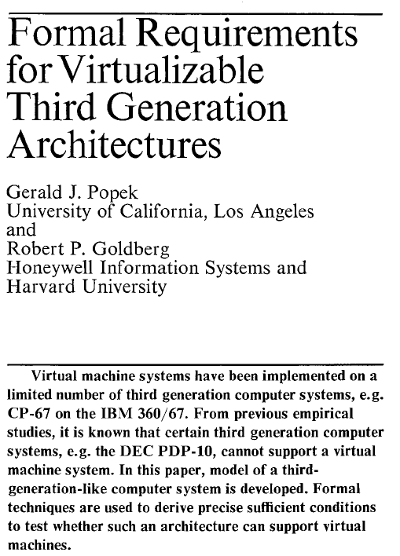
Cloud Computing Virtualization
Server virtualization is the partitioning of a physical server into multiple smaller virtual servers to maximize resources. The resources of the server are hidden from users.
Popek and Goldberg defined a set of sufficient conditions for a computer architecture to efficiently support virtualization. The set provides guidelines for the design of virtualized computer architectures
A virtual machine is an “efficient, isolated duplicate of a real machine” (Popek and Goldberg, 1974)
Run the guest operating system as a normal user process on the host. A virtual machine monitor process needs to handle: address space changes, device accesses, system calls,...
App
App
App
App
App
App
App
App
X86
Windows
XP
X86
Windows
2003
X86
Suse
X86
Red Hat
12% Hardware
Utilization
15% Hardware
Utilization
18% Hardware
Utilization
10% Hardware
Utilization
App
App
App
App
App
App
App
App
X86
Windows
XP
X86
Windows
2003
X86
Suse
X86
Red Hat
X86 Multi-Core, Multi Processor
Communications of the ACM
Vol 17, no 7, 1974, pp.412-421
70% Hardware Utilization

Slide 4









Cloud Computing From Virtualization to Clouds
Cloud Computing Deployment Stages of Enterprises
Virtualization is the base to build cloud services. Private Cloud services are used by a single organization and are not exposed to the public. Public Cloud platforms are exposed to the public and can be used by anyone. Hybrid Cloud services are distributed among public and private clouds. Typically, sensitive applications are kept inside the organization’s private network and other services can be hosted in public clouds.
Private Cloud
Hybrid Cloud
Virtualization
Data Center Consolidation
Hybrid
Cloud
Private
Public
Automatic management
Elastic resource scheduling
HA based on large clusters
Unified management
Optimal resource allocation
Flexible service migration
Computing virtualization
Storage virtualization
Network and security virtualization
Consolidation of multiple DCs
Multi-level backup and DR
Software-defined networking (SDN)
Gradually focus on business
Flexible and
service-driven
Focus on resources
Focus on global business

Slide 5
Cloud Computing Public Clouds
Amazon, Azure, Google Cloud, Oracle Cloud, VMWare, IBM, Alibaba Cloud, etc.
Transforms datacenters into pools of resources
Provides a management layer for controlling, automating, and efficiently allocating resources
Adopts a self-service mode
Enables developers to build cloud-aware applications via standard APIs
Open Telekom Cloud and Orange Business Services offer public cloud services in Germany and France, respectively.

Slide 6
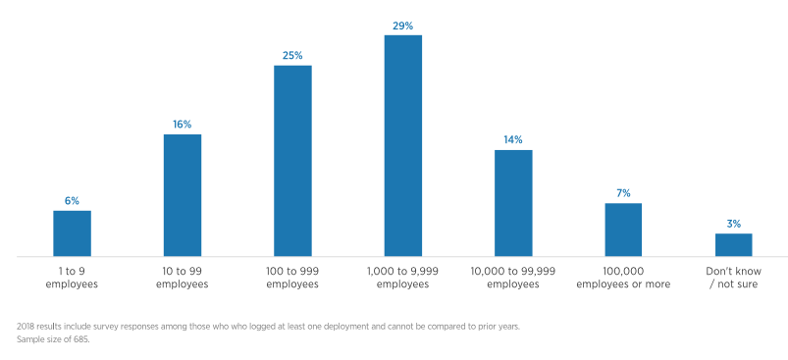
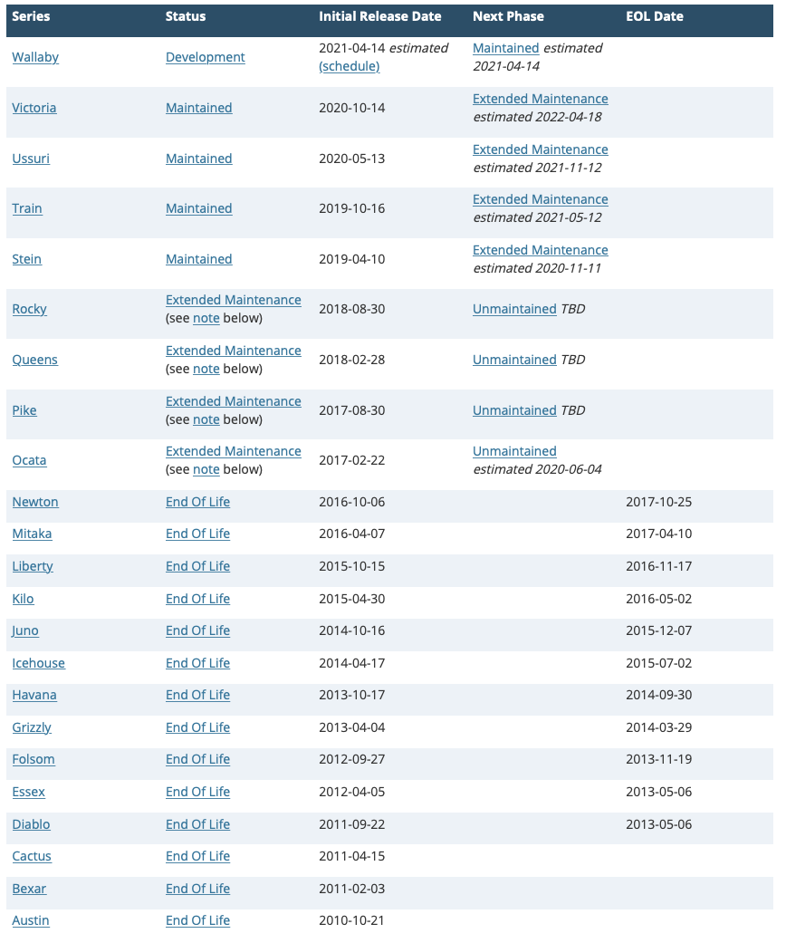
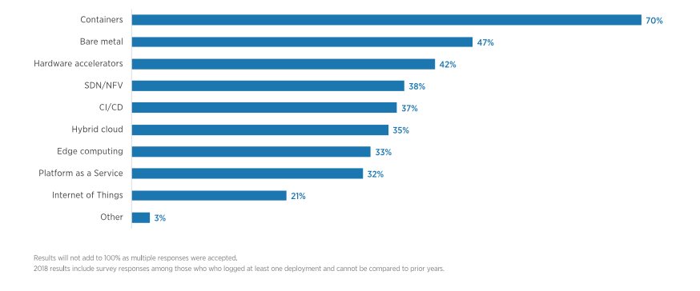
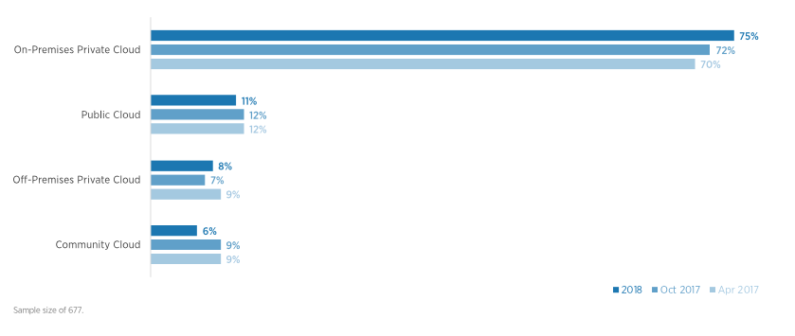
Cloud Computing OpenStack
Started by Rackspace and NASA (2010)
Driven by the emergence of virtualization
Rackspace wanted to rewrite its cloud servers offering
NASA had published code for Nova, a Python-based cloud computing controller
What size organizations use OpenStack?
25%, 100-1k employees
29%, 1k-10k employees
14%, 10k-100k employees
Which emerging technologies interest OpenStack users?
Containers
Base metal
Hardware accelerators
SDN/NFV
CI/CD
Hybrid Cloud
Edge Computing
PaaS
What types of clouds are running OpenStack
On-premises Private Cloud
Public Cloud
Off-premises Private Cloud
https://www.openstack.org/user-survey/2018-user-survey-report

Slide 7


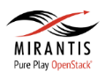











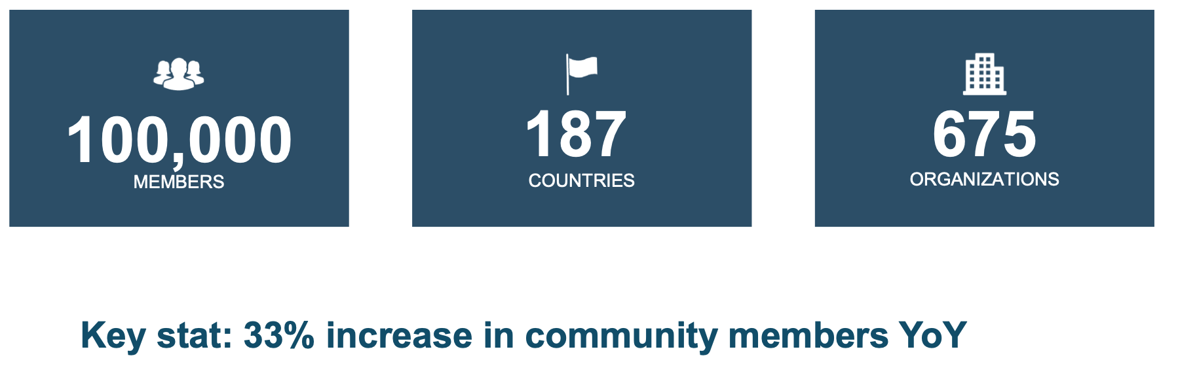
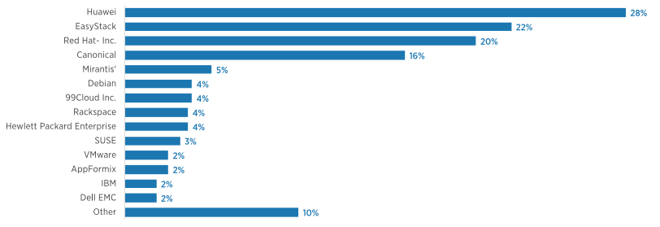
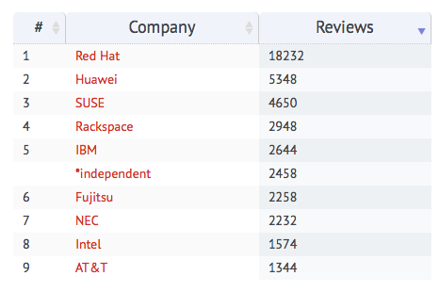
Cloud Computing OpenStack Community
1,500+ active participants
17 countries represented at Design Summit
60,000+ downloads
Worldwide network of user groups (North America, South America, Europe, Asia and Africa)
Which vendor’s OpenStack-related software products power user’s clouds?

Slide 8
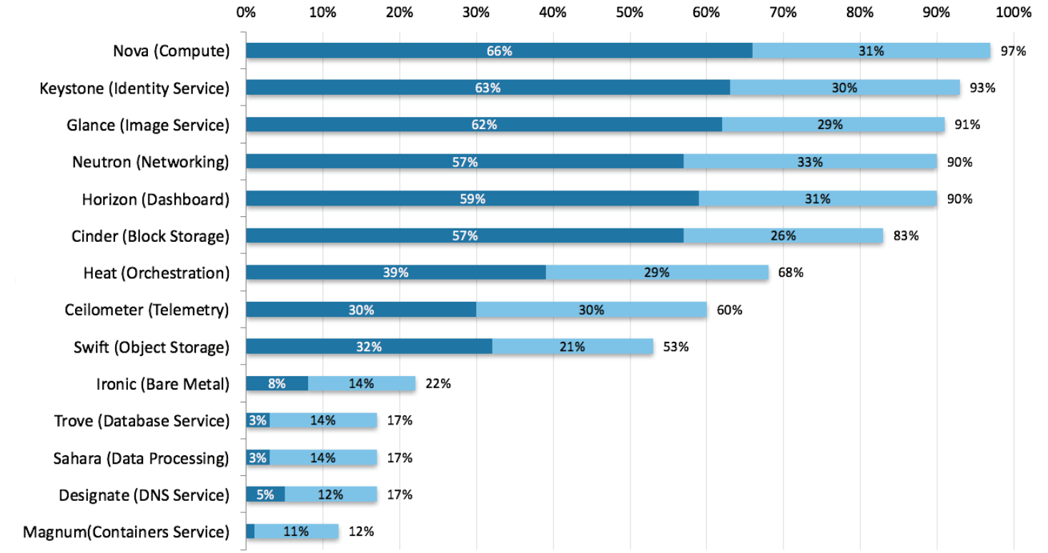
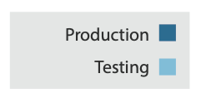
OpenStack Popular Services
Only illustrative since the chart is rather old (2016)
Additional adoption, maturity and age metrics can be viewed for all of the OpenStack projects at the Project Navigator:
https://www.openstack.org/software/project-navigator
OpenStack User Survey: A snapshot of OpenStack users’ attitudes and deployments. April 2016. (https://www.openstack.org/assets/survey/April-2016-User-Survey-Report.pdf). Fig. 4.6, Pag. 31.

Slide 9
OpenStack Basic Design Tenets
3
Message queues provide asynchronous communication and coordination for distributed components
5
6
Decentralized data management where each microservice encapsulates its own database
1. Scalability and elasticity are the main goals
2. Any feature that limits our main goals must be optional
3. Everything should be asynchronous
- If you can't do something asynchronously, see #2
4. All required components must be horizontally scalable
5. Always use shared nothing architecture or sharding
- If you can’t share nothing/shard, see #2
6. Distribute everything
- Especially logic. Move logic to where state naturally exists.
7. Accept eventual consistency and use it where it is appropriate.
8. Test everything
- We require tests with submitted code. (We will help you if you need it)
8
The system is divided into a number of smaller, individual and independent testable services
4
High availability is achieved by expecting that at least 2 servers are utilized to run each service. No single point of failure exists. Service can be replicated to increase scalability
6
Each service run as autonomous processes and communicate with one another through APIs

Slide 10
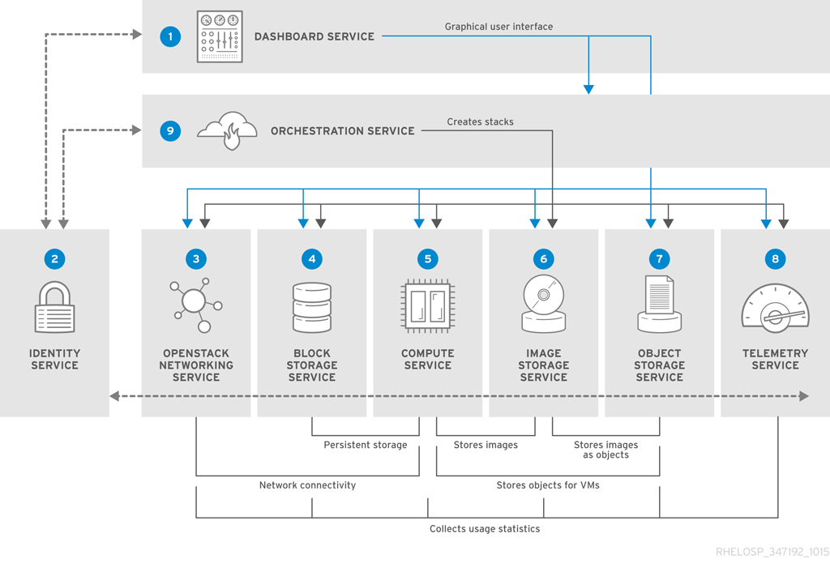
OpenStack Conceptual Architecture
OpenStack is comprised of several core projects that form a complete IaaS solution
Horizon. Dashboard
Keystone. Identity Service
Neutron. Networking
Cinder. Block Storage
Nova. Compute
Glance. Image Service
Swift. Object Storage
1. Accessing the dashboard
5. Processing the request to the compute service API
8. Choosing the hypervisor node by the compute scheduler service
2. Calling the identity service for authentication
3. Generating a token to be used for subsequent calls
4. Contacting the image service to list and retrieve a base image
10. Spinning up the instance in the hypervisor via the compute service API call
6. Processing compute service calls to determine security groups and keys
7. Calling the network service API to determine available networks
9. Calling the block storage service API to allocate volume to the instance
11. Calling the network service API to allocate network resources to the instance

Slide 11
OpenStack Key Services Dashboard Service
Key Capabilities
Thin wrapper over APIs, no local state
Openstack-dashboard. Django Web application that provides access to the dashboard from any Web browser.
HTTPservice. Apache HTTP server (httpd service)
Ships with three central dashboards, a “User Dashboard”, a “System Dashboard”, and a “Settings”
Out-of-the-box support for all core OpenStack projects
Nova, Glace, Switch, Neutron
Anyone can add a new component as a “first-class citizen”.
Follow design and style guide.
Console Access
Provides a web based user interface to OpenStack services including Nova, Swift, Keystone, etc.
Provides users a self-service portal to manage their own resources

Slide 12
OpenStack Key Services Identity Management Service
Key Capabilities
By default, the Identity service uses a MariaDB back end for token, catalog, policy, and identity information.
Identity service provides auth credential validation and data about Users, Tenants and Roles
Tenant, or project, management. Tenants can be the user group, project, or organization.
Role management. Roles determine the user permissions.
Token service validates and manages tokens used to authenticate requests after initial credential verification
Catalog service provides an endpoint registry used for endpoint discovery.
Policy service provides a rule-based authorization engine and the associated rule management interface.
REST-based APIs
The Identity service generates authentication tokens that enable clients to access OpenStack services REST APIs.
Clients obtain a token and the URL endpoints for other service APIs by supplying their credentials
The token is often passed within the structure of a larger context of an Identity service response
Two supported token types: fernet and JWT*
A token can have a variable life span; however the default value for expiry is one hour
(*) https://jwt.io , https://cryptography.io/en/2.8/fernet/

Slide 13
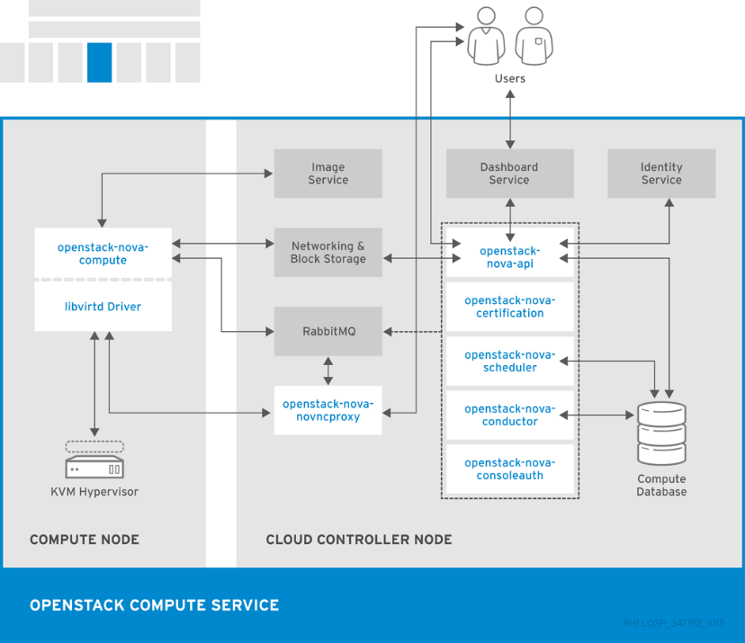
OpenStack Key Services Compute Service
Key Capabilities
Manage virtualized server resources
CPU/Memory/Disk/Network Interfaces
API with rate limiting and authentication
Distributed and asynchronous architecture
Massively scalable and highly available system
Live guest migration
Move running guests between physical hosts
Live VM management (instance)
Run, reboot, suspend, resize, terminate instances
Security Groups
Role Based Access Control (RBAC)
Ensure security by user, role and project
Projects & Quotas
VNC Proxy through web browser
It requires the following additional services:
Keystone for identity and authentication
Glance for compute images repository
Neutron for virtual or physical networks
Placement for tracking resources
Nova provides a way to provision compute instances (i.e., virtual machines or servers)
https://access.redhat.com/documentation/en/red-hat-openstack-platform/8/paged/architecture-guide/chapter-1-components
Egan Ford, OpenStack Technology Review & Demo, IBM

Slide 14
OpenStack Key Services Compute Service: Nova-API
Key Capabilities
APIs supported
OpenStack Compute API (REST-based)
Similar to RackSpace APIs
EC2 API (subset)
Can be excluded
Admin API (nova-manage)
Robust extensions mechanism to add new capabilities
End users and components communicate with nova-api interface to create instances via the OpenStack API or EC2 API.

Slide 15

OpenStack Key Services Compute Service: RabbitMQ and Database
Key Capabilities
Responsible for providing communications hub and managing data persistence
RabbitMQ is default queue, MySQL DB
Documented HA methods
ZeroMQ implementation available to decentralize queue
Single “cell” (1 Queue, 1 Database) typically scales from 500 – 1000 physical machines
Cells can be rolled up to support larger deployments
Communications route through queue
API requests are validated and placed on queue
Workers listen to queues based on role or role + hostname
Responses are dispatched back through queue
Advantages: buffer requests, decoupling, unicast and group-based communication
Message Queue provides a central hub to pass messages between different services in an asynchronous way
Stores build-time and run-time states, including available instance types, instances in use, available networks…

Slide 16
OpenStack Key Services Compute Service: Scheduler
Key Capabilities
Determines which physical hardware to allocate to a virtual resource
Default scheduler uses a series of filters to reduce set of applicable hosts and uses costing functions to provide Weight
Not a focus point for OpenStack
Default implementation finds first fit
Shorter the workload lifespan, less critical the placement decision
If default does not work, often deployers have specific requirements and develop custom
nova-scheduler takes a VM instance's request from the queue and determines which compute host it should run on
nova-conductor prevents direct database access from the compute nodes to enhance database security

Slide 17
OpenStack Key Services Compute Service: Node
Key Capabilities
Responsible for managing all interactions with individual endpoints providing compute resource, e.g.
Attach iSCSI volume to physical host, map to guest as additional HDD
Implementations direct to native hypervisor APIs
Avoids abstraction layers that bring least common denomination support
Enables easier exploitation of hypervisor differentiators
Service instance runs on every physical compute node, helps to minimize failure domain
Support for security groups that define firewall rules
Support for
KVM, LXC, VMware ESX/ESXi (4.1 update 1), Xen (XenServer 5.5, Xen Cloud Platform), Hyper V
The majority of nova deployments use libvirt/kvm, but other compute drivers can be used
nova-compute is a daemon that creates and terminates VM instances via the hypervisor’s APIs

Slide 18
OpenStack Key Services Network Service
Key Capabilities
Responsible for managing networks, ports, and attachments on infrastructure for virtual resources
Create/delete tenant-specific L2 networks
L3 support (Floating IPs, DHCP, routing)
NAT including services such as FWaaS and LBaaS
Attach / detach host to network
Support for
Open vSwitch
OpenFlow (NEC & Floodlight controllers)
Cisco Nexus
Niciria
Network as a Service (NaaS) capability between interface devices that are managed by nova
Users can create their own networks and attach server interfaces to them
Open vSwitch (OVS) agent implements L2 (e.g., MAC) connectivity by plugging ports onto OVS bridges
L3 (e.g., IP) agents run only on network nodes and provide routing and NAT services

Slide 19
OpenStack Key Services Block Storage Service
Key Capabilities
Responsible for managing lifecycle of volumes and exposing for attachment
Structure is a copy of Compute (Nova), sharing same characteristics and structure in API server, scheduler, etc.
Enables additional attached persistent block storage to virtual machines
Support for booting virtual machines from nova-volume backed storage
Allows multiple volumes to be attached per virtual machine
Backs up a Block Storage volume to an external storage repository.
Supports
NFS, Ceph distributed file system, etc.
Accepts API requests, and routes them to the cinder-volume for action
Responds to read and write requests sent to the Block Storage service to maintain state
Selects the storage provider node on which to create the volume
Provides backing up volumes to a backup storage provider

Slide 20
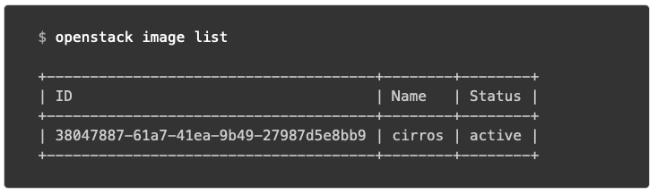
OpenStack Key Services Image Storage Service
Key Capabilities
REST-based APIs
Query for information on public and private disk images
Register new disk images
Disk images can be stored in and delivered from a variety of stores (e.g. SoNFS, Swift)
Supported formats
aki/ami/ari (Amazon kernel, ramdisk, or machine image)
iso (archive format for optical discs, such as CDs)
qcow2 (Qemu/KVM, supports Copy on Write)
raw (unstructured format)
vhd (Hyper-V, common for virtual machine monitors from vendors such as VMware, Xen, Microsoft, and VirtualBox)
Users can add new images or take a snapshot of an existing server for storage
Stores, processes, and retrieves metadata about images. Metadata includes items such as size and type
Accepts API calls for image discovery, retrieval, and storage

Slide 21
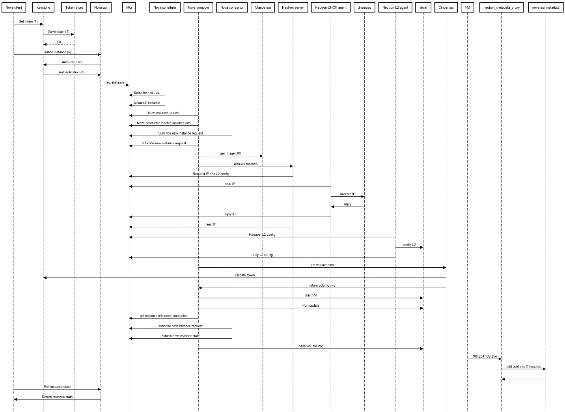
OpenStack Operation Server Creation Workflow
Nova client-> Keystone: Get token (1)
Keystone-> Token Store: Save token (2)
Token Store--> Keystone: (3)
Keystone-->-Nova client: Auth token (4)
Nova client-> Nova-api: launch instance (5)
Nova-api-> Keystone: Auth token (6)
Keystone->Nova-api: Authentication (7)
Nova-api->MQ: req. instance
Nova-scheduler->MQ: Subscribe inst. req.
Nova-scheduler->MQ: to launch instance
Nova-compute->MQ: New instance request
Nova-compute->MQ: Nova-conductor to fetch instance info
Nova-conductor->MQ: Subscribe new instance request
Nova-compute->MQ: Subscribe new instance request
Nova-compute-> Glance-api: get Image URI
Glance-api->-Nova-compute: Return image URI
Nova-compute->Neutron-server: allocate network
Neutron-server->MQ: Request IP and L2 config
Neutron-DHCP-agent->MQ: read IP
Neutron-DHCP-agent->dnsmasq: allocate IP
dnsmasq->Neutron-DHCP-agent: reply
Neutron-DHCP-agent->MQ: reply IP
Neutron-server->MQ:read IP
Neutron-L2-agent->MQ: Request L2 config
Neutron-L2-agent->libvirt: config L2
Neutron-L2-agent->MQ: reply L2 config
Neutron-server->-Nova-compute: net info
Nova-compute->Cinder-api: get volume data
Cinder-api->Keystone: validate token
Keystone-->-Cinder-api: updated auth headers with roles and acl
Cinder-api->Nova-compute: return volume info
Nova-compute->libvirt: Start VM
Nova-compute->libvirt: Port update
Nova-compute->MQ: get instance info nova-conductor
Nova-conductor->MQ: subcribe new instance request
Nova-conductor->MQ: publish new instance state
Nova-compute->libvirt: pass volume info
VM->neutron_metadata_proxy: 169.254.169.254
neutron_metadata_proxy->nova-api-metadata: add uuid into X-headers
nova-api-metadata->neutron_metadata_proxy:
neutron_metadata_proxy->-VM-instance: return metadata
Nova client->Nova-api: Poll instance state
Nova-api-> Nova client: Return instance state
https://sequencediagram.org/

Slide 22
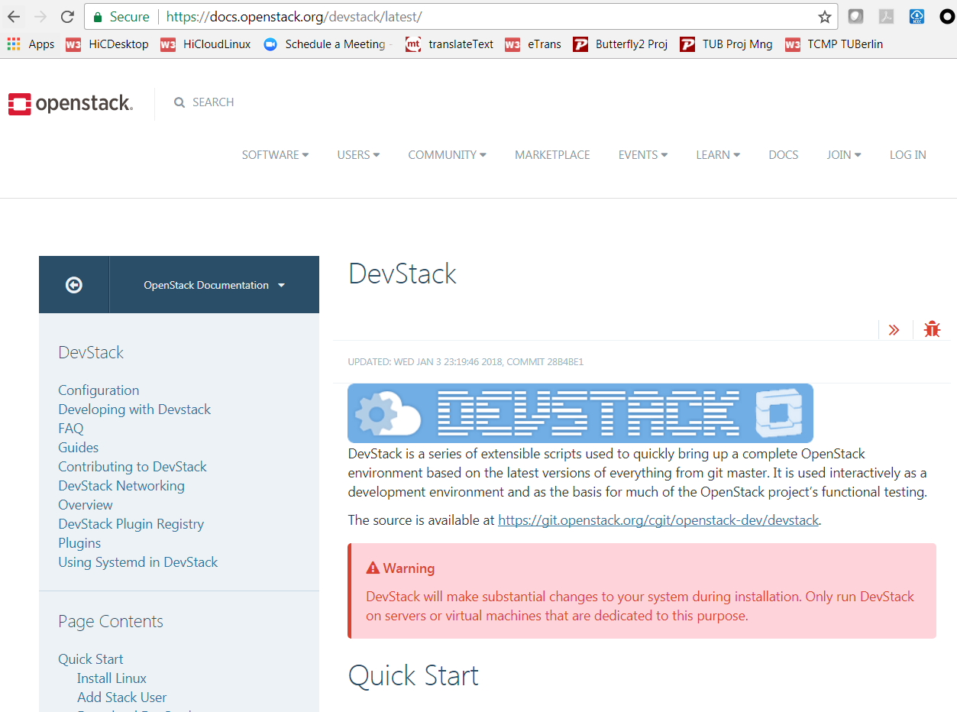
OpenStack DevStack Deployment
1
2
Create a VM at LRZ TU Munich
16 GB, image: Ubuntu_20G, 1 vCPU, (optional: access to the Internet)
Generate ssh key pairs: lrz and lrz.pub
Copy the public key lrz.pub in the field SSH_PUBLIC_KEY
Take a note of the public IP
Access the LRZ VM
ssh-keygen -R 141.40.254.130 (in case you rebuild your VM)
ssh -i lrz -v root@141.40.254.130
Install Openstack
Follow the instructions at https://docs.openstack.org/devstack/latest/
Add Stack User
$ sudo useradd -s /bin/bash -d /opt/stack -m stack
$ echo "stack ALL=(ALL) NOPASSWD: ALL" | sudo tee /etc/sudoers.d/stack
$ sudo su - stack
Download DevStack¶
$ git clone https://git.openstack.org/openstack-dev/devstack
$ cd devstack
Create a local.conf
Start the install
./stack.sh
Wait 15 - 20 minutes
Inspecting the services installed
sudo systemctl status "devstack@*"
Inspecting the code of the services
ls –al /opt/stack/
Inspecting the dashboard (Horizon)
http://141.40.254.130/
User Name: admin
Password: admin (specified in the file local.conf)
https://docs.openstack.org/install-guide/get-started-logical-architecture.html

Slide 23

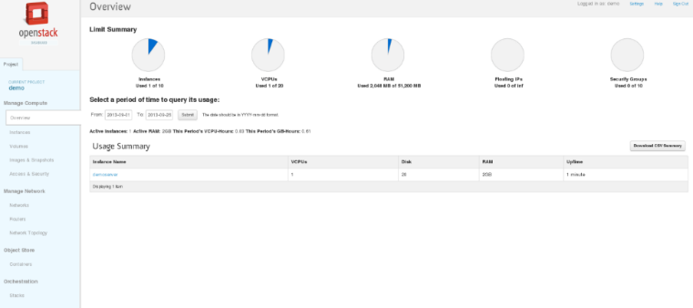
OpenStack RDO Deployment
https://www.rdoproject.org/install/quickstart/
If you are using non-English locale make sure your /etc/environment is populated:
LANG=en_US.utf-8
LC_ALL=en_US.utf-8
On RHEL:
$ sudo yum install -y https://www.rdoproject.org/repos/rdo-release.rpm
$ sudo yum update –y
$ sudo yum install -y openstack-packstack
$ sudo packstack --allinone
On CentOS:
$ sudo yum install -y centos-release-openstack-pike
$ sudo yum update –y
$ sudo yum install -y openstack-packstack
$ sudo packstack --allinone

Slide 24
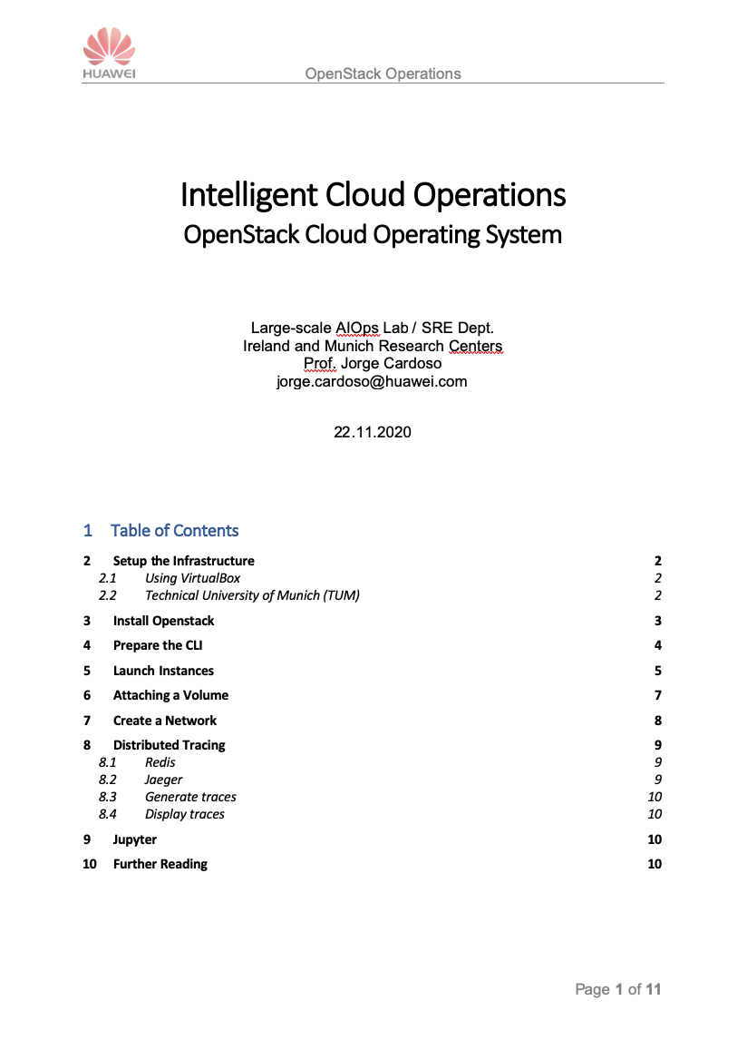
OpenStack Hands-on Exercises
The following document contains the exercises for this lecture
Setup the Infrastructure
Install Openstack
Prepare the CLI
Launch Instances
Attaching a Volume
Create a Network

Slide 25
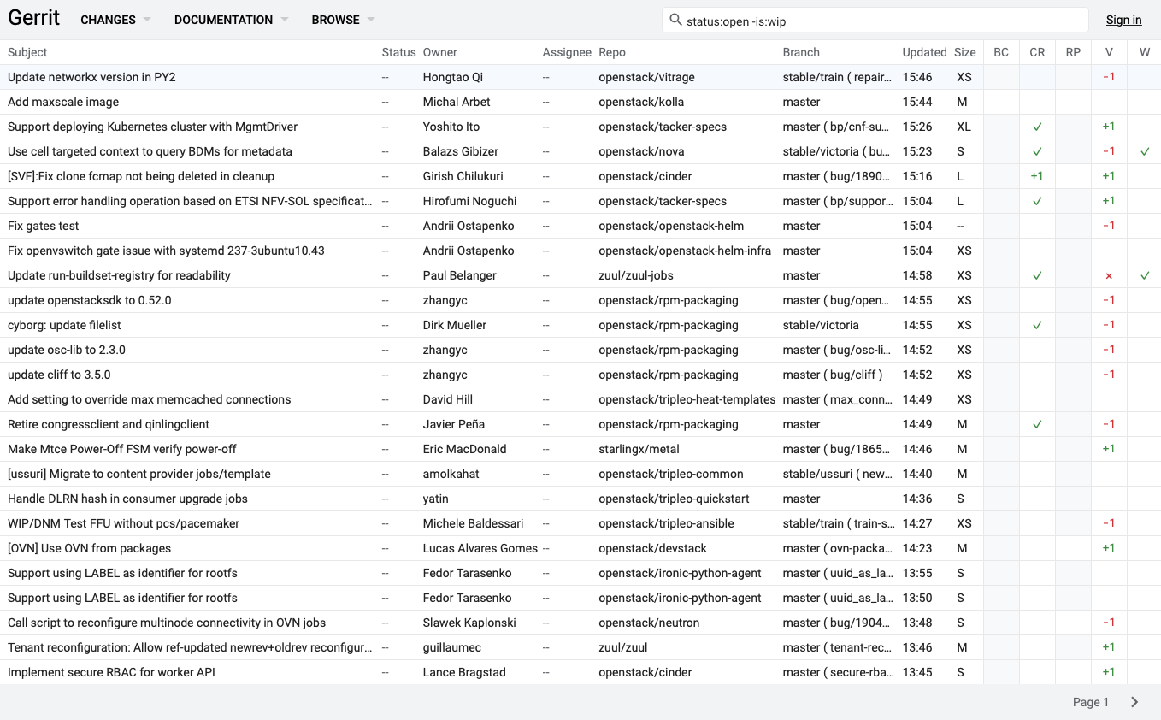
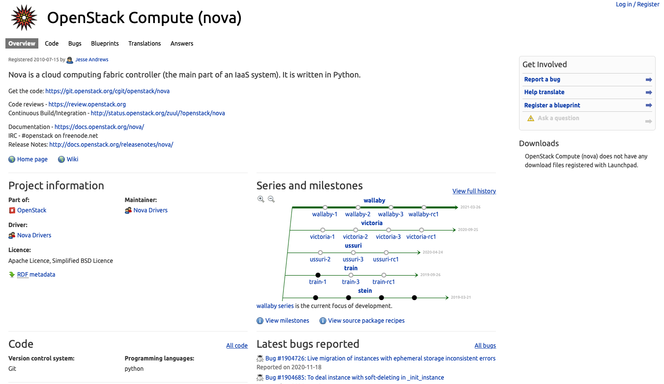
OpenStack Resources
Website: http://openstack.org
Q&A: https://ask.openstack.org/en/questions/
Wiki: http://wiki.openstack.org/
Documentation: http://docs.openstack.org/
Code Review: https://review.openstack.org/
Mailing Lists: http://wiki.openstack.org/MailingLists
Projects: https://launchpad.net/openstack
Blogs: http://planet.openstack.org
Real-time chat room: #openstack and #openstack-dev on irc://freenode.net (443 users currently logged in)
Code Review
Projects

